Slide 1
ASA DataFest 2021 The Data Eaters
Yi Heng Wang
Yaqi Shi
Laiba Zaman
Nina Tan

Slide 2
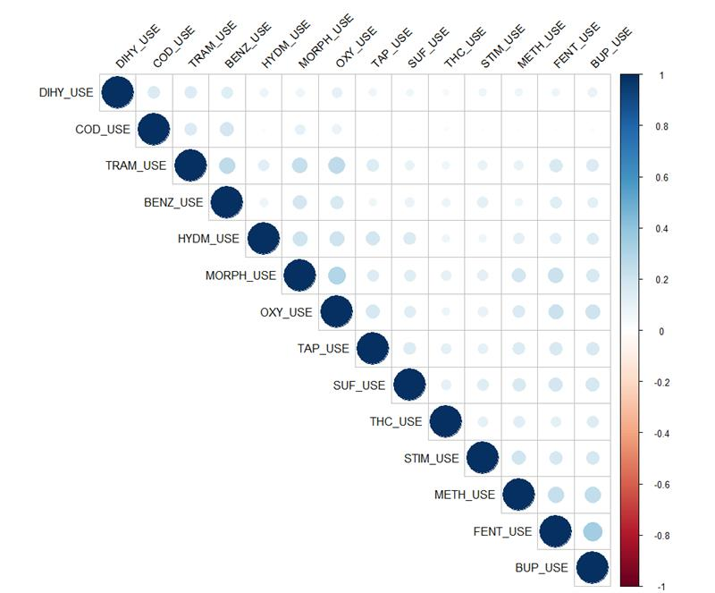
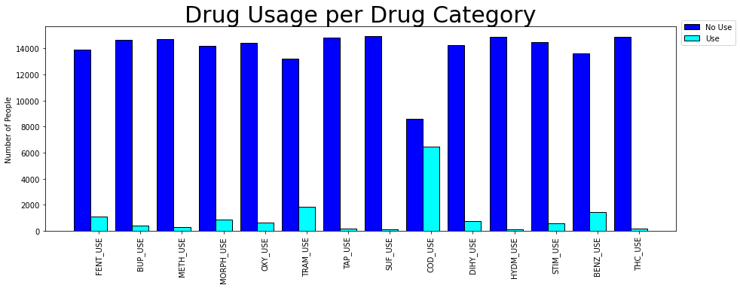
What drugs and combinations of drugs are used together?
Analgesic (pain reliever) drugs

Slide 3
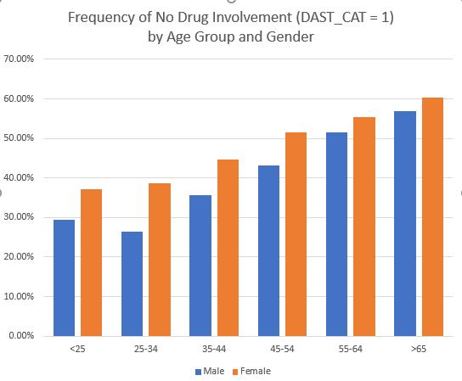
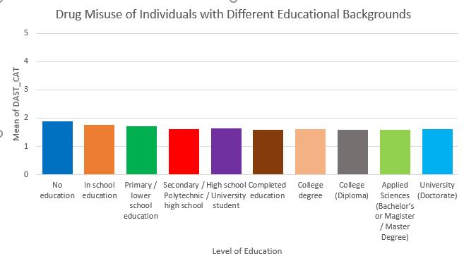
What demographic profiles contribute most to overall drug usage?
Using DAST_CAT variable as a metric for (non-medical) drug involvement (ranging from 1 to 5)

